Slide 1
CHAPTER 5 Trees
All the programs in this file are selected from
Ellis Horowitz, Sartaj Sahni, and Susan Anderson-Freed
“Fundamentals of Data Structures in C”,

Slide 2
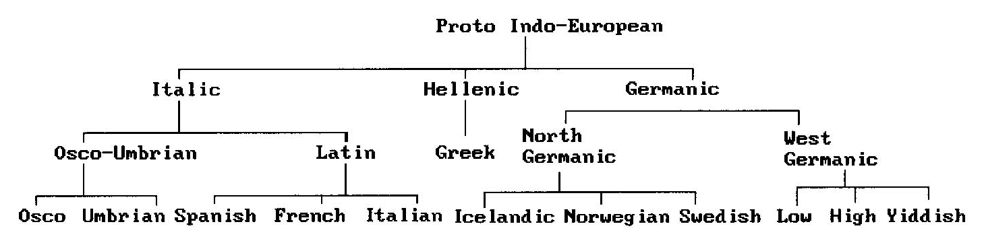
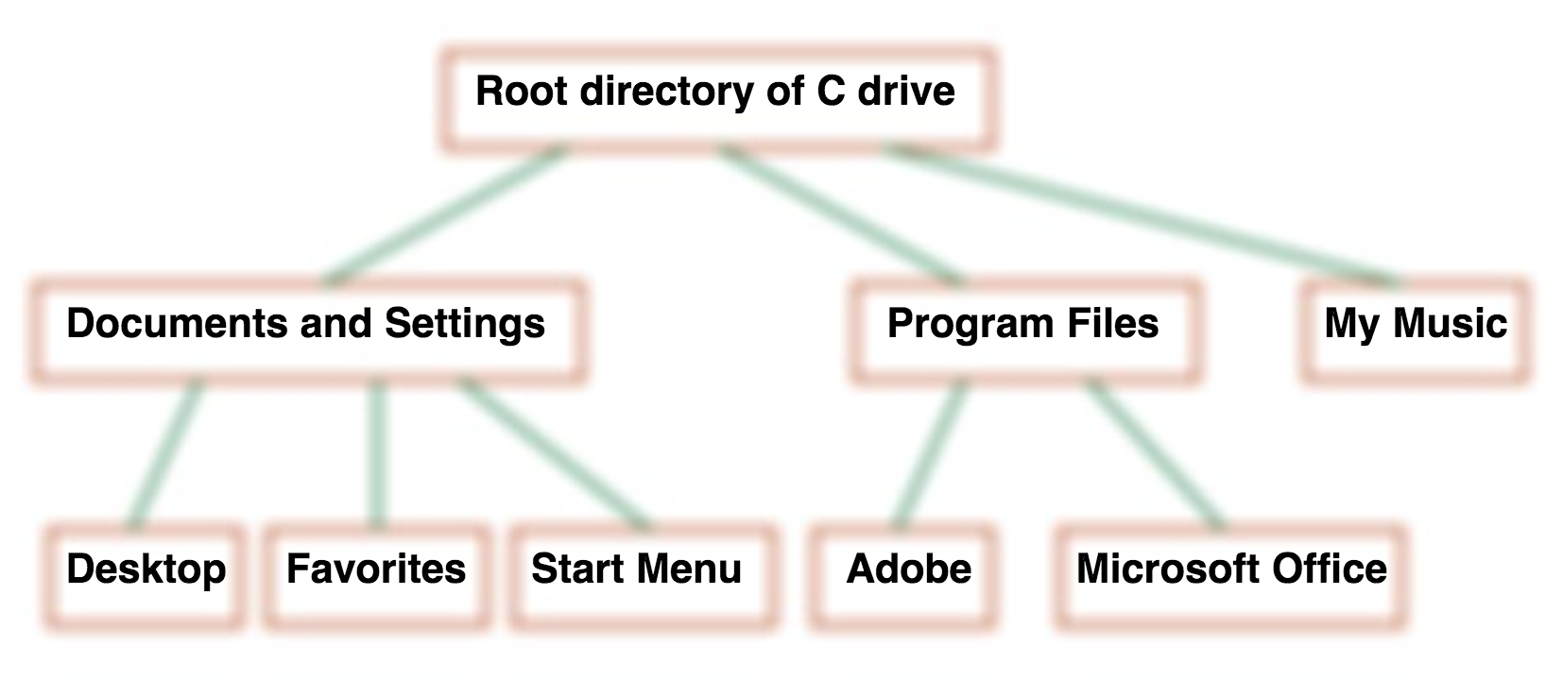
Trees
Root
Leaf
Root
Leaf

Slide 3
Definition of (Rooted) Tree
A tree is a finite set of one or more nodes such that:
There is a specially designated node called the root.
The remaining nodes are partitioned into n>=0 disjoint sets T1, ..., Tn, where each of these sets is a tree.
We call T1, ..., Tn the subtrees of the root.
Root
Subtree
Subtree
Subtree

Slide 4
Terminology
Degree of a node: the number of subtrees of the node
The degree of A is 3; the degree of C is 1
Degree of a tree: the maximum degree of the tree’s nodes

Slide 5
Terminology
Leaf or terminal node: the node with degree 0
Parent of a node: the node directly above in the hierarchy
Children of a node: the nodes directly below in the hierarchy
Siblings of a node: the nodes with the same parent
Ancestors of a node: all the nodes along the path from the root to the node

Slide 6
Terminology
Level of a node: the number of edges between root and the node plus one
Height or depth of a tree: the maximum level of any nodes in the tree

Slide 7
Example
Number of nodes = 13
Degree of node A = 3
Leaf (terminal) = {K, L, F, G, M, I, J}
Nonterminal: others
Parent of node B = A
Children of node A = {B, C, D}
Siblings of node C = {B, D}
Degree of the tree = 3
Ancestors of node M = {A, D, H}
Level of node F = 3
Height of the tree = 4
Level
1
2
3
4
3
1
2
2
1
2
3
2
2
3
3
3
3
0
1
3
3
0
0
0
0
4
0
4
0
4
*Figure 5.2: A sample tree (p.193)

Slide 9


Tree and Multicast
Unicast duplicates the packets and thus increases the load of a server and waste the network bandwidth

Slide 10
Tree and Multicast
Multicast reduces the load of a server to 1/d, and saves 50% network bandwidth in average

Slide 11
Tree and Multicast

Slide 13
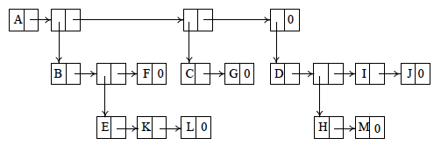
Representation of Trees
List Representation
( A ( B ( E ( K, L ), F ), C ( G ), D ( H ( M ), I, J ) ) )
The root comes first, followed by a list of sub-trees
Notes:
對於一個 parent 來說，不是 leaf 的 child 才建立中間點，否則直接串起來

Slide 14
Representation of Trees
It is desirable to have a specialized representation
Represent each tree node by a memory node that has fields for the data and pointers to the tree node’s children
Node in a tree of degree k:
data
link 1
link 2
...
link k
How many link fields are
wasted in such a representation?

Slide 15
How many fields are wasted?
If T is a k-ary tree (i.e., a tree of degree k) with n nodes, each having a fixed size, then n(k-1)+1 of the nk child fields are 0, n ≥ 1.
How many fields are created?
How many fields are used?

Slide 16
How many fields are wasted?
If T is a k-ary tree (i.e., a tree of degree k) with n nodes, each having a fixed size, then n(k-1)+1 of the nk child fields are 0, n ≥ 1.
How many fields are created? nk
How many fields are used?

Slide 17
How many fields are wasted?
If T is a k-ary tree (i.e., a tree of degree k) with n nodes, each having a fixed size, then n(k-1)+1 of the nk child fields are 0, n ≥ 1.
How many fields are created? nk
How many fields are used? n-1

Slide 18
How many fields are wasted?
If T is a k-ary tree (i.e., a tree of degree k) with n nodes, each having a fixed size, then n(k-1)+1 of the nk child fields are 0, n ≥ 1.
How many fields are created? nk
How many fields are used? n-1

Slide 19
Left Child - Right Sibling
data
A
left child
right sibling
B
C
D
E
F
G
H
I
J
K
L
M
*Figure 5.6: Left child-right sibling representation of tree of Figure 5.2 (p.196)

Slide 21
Binary Trees
A binary tree is a finite set of nodes that is either empty or consists of a root and two disjoint binary trees called the left subtree and the right subtree
Any tree can be transformed into binary tree.
by left child-right sibling representation
The left subtree and the right subtree are distinguished.

Slide 22
A
B
E
C
G
D
K
F
H
L
M
I
J
*Figure 5.7: Left child-right child tree representation of tree of Figure 5.2 (p.197)

Slide 23
Trees and Binary Trees
Are the two following trees identical?
Are the two following binary trees different?
A
A
B
B

Slide 24
Abstract Data Type Binary_Tree
ADT Binary_Tree (abbreviated BinTree) is
objects: a finite set of nodes either empty or consisting of a root node, left Binary_Tree, and right Binary_Tree.
functions:
for all bt, bt1, bt2 ∈ BinTree, item ∈ element
Bintree Create()::= creates an empty binary tree
Boolean IsEmpty(bt)::= if (bt==empty binary tree)
return TRUE else return FALSE

Slide 25
BinTree MakeBT(bt1, item, bt2)::= return a binary tree
whose left subtree is bt1, whose right subtree is bt2,
and whose root node contains the data item
BinTree Lchild(bt)::= if (IsEmpty(bt)) return error else return the left subtree of bt
element Data(bt)::= if (IsEmpty(bt)) return error else return the data in the root node of bt
BinTree Rchild(bt)::= if (IsEmpty(bt)) return error else return the right subtree of bt

Slide 26
Samples of Binary Trees
Skewed Binary Tree
Complete Binary Tree
A
1
A
B
B
C
2
C
D
E
F
G
3
D
H
I
4
E
5
*Figure 5.10: Skewed and complete binary trees (p.200)

Slide 27
Maximum Number of Nodes in BinTree
The maximum number of nodes on level i of a binary tree is 2^{i-1}, i ≥ 1.
The maximum nubmer of nodes in a binary tree of depth k is 2^{k}-1, k ≥ 1.
Prove by induction.

Slide 28
Relations between Number of Leaf Nodes and Nodes of Degree 2
Lemma 5.3. For any nonempty binary tree, T, if n₀ is the number of leaf nodes and n₂ the number of nodes of degree 2, then n₀=n₂+1
Proof:
Let n and B denote the total number of nodes &
branches (edges) in T.
Let n₀, n₁, n₂ represent the nodes with no children,
single child, and two children respectively.
B=n-1, B=n₁+2n₂ ➔ n₁+2n₂+1= n,
n = n₀+n₁+n₂ = n₁+2n₂+1➔ n₀=n₂+1

Slide 29
Full BinTree and Complete BinTree
A full binary tree of depth k is a binary tree of depth k having 2^{k}-1 nodes, k >= 0.
A binary tree with n nodes and depth k is complete iff its nodes correspond to the nodes numbered from 1 to n in the full binary tree of depth k.
由上至下，
由左至右編號
A
A
B
B
C
C
D
E
F
G
D
E
F
G
H
I
J
K
L
M
N
O
H
I
Complete binary tree
Full binary tree of depth 4

Slide 31
Binary Tree Representations
If a complete binary tree with n nodes (depth = log n + 1) is represented sequentially, then for any node with index i, 1 ≤ i ≤ n, we have:
parent(i) is at ⌊ i/2 ⌋ if i ≠ 1. If i = 1, i is at the root and has no parent.
leftChild(i) ia at 2i if 2i ≤ n. If 2i > n, then i has no left child.
rightChild(i) ia at 2i+1 if 2i +1 ≤ n. If 2i +1 > n, then i has no right child.

Slide 32
Sequential Representation
[1]
[2]
[3]
[4]
[5]
[6]
[7]
[8]
[9]
…
[16]
A
B
--
C
--
--
--
D
--
…
E
[1]
[2]
[3]
[4]
[5]
[6]
[7]
[8]
[9]
A
B
C
D
E
F
G
H
I
A
A
B
B
C
C
D
E
F
G
D
E
H
I
(1) waste space
(2) insertion/deletion
problem
*Figure 5.12: Array representation of the binary trees (p.203)

Slide 33
Linked Representation
typedef struct node *treePointer;
typedef struct node {
int data;
treePointer leftChild, rightChild;
};
data
leftChild
data
rightChild
leftChild
rightChild
*Figure 5.13: Node representations (p.204)

Slide 34
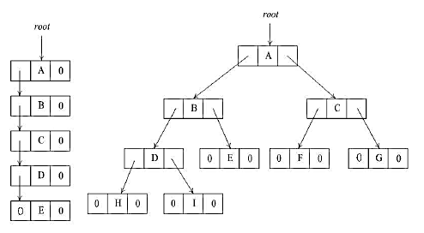
*Figure 5.14: Linked representation for the binary trees (p.205)

Slide 36
Binary Tree Traversals
Let L, V, and R stand for moving left, visiting the node, and moving right.
There are six possible combinations of traversal
LVR, LRV, VLR, VRL, RVL, RLV
Adopt convention that we traverse left before right, only 3 traversals remain
LVR, LRV, VLR
inorder, postorder, preorder

Slide 37
Arithmetic Expression Using BT
+
inorder traversal (LVR)
A / B * C * D + E
infix expression
preorder traversal (VLR)
+ * * / A B C D E
prefix expression
postorder traversal (LRV)
A B / C * D * E +
postfix expression
level order traversal
+ * E * D / C A B
*
E
*
D
/
C
A
B
*Figure 5.16: Binary tree with arithmetic expression (p.206)

Slide 38
Inorder Traversal (recursive version)
void inorder(treePointer ptr)
/* inorder tree traversal */
{
if (ptr) {
inorder(ptr->leftChild);
printf(“%d”, ptr->data);
inorder(ptr->rightChild);
}
}
A / B * C * D + E
* Program 5.1: Inorder traversal of a binary tree (p.207)

Slide 39
Trace Operations of Inorder Traversal

Slide 40
Trace Operations of Inorder Traversal

Slide 41
Preorder Traversal (recursive version)
void preorder(treePointer ptr)
/* preorder tree traversal */
{
if (ptr) {
printf(“%d”, ptr->data);
preorder(ptr->leftChild);
preorder(ptr->rightChild);
}
}
+ * * / A B C D E
*Program 5.2: Preorder traversal of a binary tree (p.208)

Slide 42
Postorder Traversal (recursive version)
void postorder(treePointer ptr)
/* postorder tree traversal */
{
if (ptr) {
postorder(ptr->leftChild);
postorder(ptr->rightChild);
printf(“%d”, ptr->data);
}
}
A B / C * D * E +
*Program 5.3: Postorder traversal of a binary tree (p.209)

Slide 43
Simulate Recursion of Inorder Traversal
Push
Push
Push
Push
Pop
Push
Push
Pop
Push
Pop
Pop
Pop
Push
Pop
Push
Pop
Pop
Pop

Slide 44
Simulate Recursion of Inorder Traversal
Push
Pop
Pop
Push
Pop
Pop
Push
Pop

Slide 45
Iterative Inorder Traversal (using stack)
void iterInorder(treePointer node)
{
int top= -1; /* initialize stack */
treePointer stack[MAX_STACK_SIZE];
for (;;) {
for (; node; node=node->leftChild)
push(node);/* add to stack */
node= pop(&top);
/* delete from stack */
if (!node) break; /* empty stack */
printf(“%D”, node->data);
node = node->rightChild;
}
}
O(n)
*Program 5.4: Iterative inorder traversal (p.210)

Slide 47
Level Order Traversal (using queue)
void levelOrder(treePointer ptr)
/* level order tree traversal */
{
int front = rear = 0;
treePointer queue[MAX_QUEUE_SIZE];
if (!ptr) return; /* empty queue */
addq(front, &rear, ptr);
for (;;) {
ptr = deleteq(&front, rear);

Slide 48
if (ptr) {
printf(“%d”, ptr->data);
if (ptr->leftChild)
addq(front, &rear,
ptr->leftChild);
if (ptr->rightChild)
addq(front, &rear,
ptr->rightChild);
}
else break;
}
}
+ * E * D / C A B
*Program 5.5: Level-order traversal of a binary tree (p.211)

Slide 50
Copying Binary Trees
treePoointer copy(treePointer original)
{
treePointer temp;
if (original) {
MALLOC(temp, sizeof(*temp));
temp->leftChild=copy(original->leftChild);
temp->rightChild=copy(original->rightChild);
temp->data=original->data;
return temp;
}
return NULL;
}
*Program 5.6: Copy a binary tree (p.212)
Postorder version

Slide 51
Equality of Binary Trees
int equal(treePointer first, treePointer second)
{
/* function returns FALSE if the binary trees first and
second are not equal, otherwise it returns TRUE */
return ((!first && !second) || (first && second &&
(first->data == second->data) &&
equal(first->leftChild, second->leftChild) &&
equal(first->rightChild, second->rightChild));
}
*Program 5.6: Copy a binary tree (p.212)
Preorder version

Slide 52
Equality and Similarity
Equality
Similarity
Subgraph query
Application
Pattern discovery in brain networks
Network embedding

Slide 54
Propositional Calculus Expression
Not | And | Or
¬ | ∧ | ∨
A variable is an expression.
If x and y are expressions, then ¬ x, x ∧ y, x ∨ y are expressions.
Parentheses can be used to alter the normal order of evaluation (¬ > ∧ > ∨).
The Satisfiability Problem: Is there an assignment to make an expression true?
Example: x₁ ∨ (x₂ ∧ ¬ x₃)
x₁=false, x₂=true, x₃=false

Slide 55
Example
(x₁ ∧ ¬ x₂) ∨ (¬ x₁ ∧ x₃) ∨ ¬ x₃
(t, t, t)
(t, t, f)
(t, f, t)
(t, f, f)
(f, t, t)
(f, t, f)
(f, f, t)
(f, f, f)
2^{n} possible combinations
for n variables
∨
∨
¬
∧
∧
X₃
X₁
¬
¬
X₃
X₂
X₁
*Figure 5.18: Proposition formula in a binary tree (p.214)
Evaluation: postorder traversal (postfix evaluation)

Slide 56
Node Structure
leftChild data value rightChild
typedef emun {not, and, or, true, false} logical; typedef struct node *treePointer; typedef struct node { treePointer leftChild; logical data; // ¬, ∧, ∨, true, false short int value; treePointer rightChild; } ;
*Figure 5.19: Node structure for the satisfiability problem (p.215)

Slide 57
for (all 2^{n} possible combinations) { generate the next combination; replace the variables by their values; evaluate root by traversing it in postorder; if (root->value) { printf(<combination>); return; } } printf(“No satisfiable combination\n”);
First version of satisfiability algorithm
*Program 5.8: First version of satisfiability algorithm (p.216)

Slide 58
void postOrderEval(treePointer node) { /* modified post order traversal to evaluate a propositional calculus tree */ if (node) { postOrderEval(node->leftChild); postOrderEval(node->rightChild); switch(node->data) { case not: node->value = !node->rightChild->value; break;
Postorder evaluation Function

Slide 59
case and: node->value = node->rightChild->value && node->leftChild->value; break; case or: node->value = node->rightChild->value | | node->leftChild->value; break; case true: node->value = TRUE; break; case false: node->value = FALSE; } } }
*Program 5.9: Postorder evaluation function (p.217)

Slide 60
3-SAT problem
A well-known NP-Complete problem
Given the clauses and literals, ask whether there is a truth assignment
literal
clause
(x₁ ∨ x₂ ∨ x₄) ∧
(¬ x₁ ∨ ¬ x₂ ∨ ¬ x₃) ∧
(¬ x₁ ∨ x₃ ∨ x₄)

Slide 62
Threaded Binary Trees
Two many null pointers in current representation of binary trees n: number of nodes number of non-null links: n-1 total links: 2n null links: 2n-(n-1)=n+1
Replace these null pointers with some useful “threads”.

Slide 63
Threaded Binary Trees (Continued)
If ptr->leftChild is null,
replace it with a pointer to the node that would be
visited before ptr in an inorder traversal
If ptr->rightChild is null,
replace it with a pointer to the node that would be
visited after ptr in an inorder traversal

Slide 64
Threaded Binary Tree
root
A
B
C
D
E
F
G
inorder traversal:
H, D, I, B, E, A, F, C, G
H
I
*Figure 5.21: Threaded tree (p.217)

Slide 65
Normal Pointers and Threads
To distinguish between threads and normal pointers, two Boolean fields, LeftThread and RightThread, are added to the node structure
if ptr-> leftThread = TRUE
ptr-> LeftChild is a thread
if ptr-> leftThread = FALSE
ptr->LeftChild is a pointer to the left child

Slide 66
Data Structures for Threaded BT
leftThread leftChild data rightChild rightThread
TRUE
●
●
FALSE
TRUE: thread
FALSE: child
typedef struct threadedTree *threadedPointer;
typedef struct threadedTree {
bool leftThread;
threadedPointer leftChild;
char data;
threadedPointer rightChild;
bool rightThread;
};

Slide 67
Problem: Null Pointers
root
A
Null
B
C
Null
D
E
F
G
inorder traversal:
H, D, I, B, E, A, F, C, G
H
I
*Figure 5.21: Threaded tree (p.217)

Slide 68
Header Node for Empty Tree
To leave no loose threads, a header node is used in representing a binary tree
The dangling threads point to the header node
The original tree becomes the left subtree of the header node
leftThread leftChild data rightChild rightThread
TRUE
●
●
FALSE
TRUE: thread
FALSE: child
*Figure 5.22: An empty threaded binary tree (p.219)

Slide 69
Memory Representation of A Threaded BT
header
f
--
f
f
A
f
f
B
f
f
C
f
f
D
f
t
E
t
t
F
t
t
G
t
t
H
t
t
I
t
inorder traversal:
H, D, I, B, E, A, F, C, G
*Figure 5.23: Memory representation of threaded tree (p.219)

Slide 70
Next Node in Threaded BT
threadedPointer insucc(threadedPointer tree)
{
threadedPointer temp;
temp = tree->rightChild;
if (!tree->rightThread)
while (!temp->leftThread)
temp = temp->leftChild;
return temp;
}
We can perform an inorder traversal without making use of a stack
*Program 5.10: Finding the inorder successor of a node (p.220)
Notes:
注意中間的 if 表示 不是 thread pointer 才做

Slide 71
Inorder Traversal of Threaded BT
void tinorder(threadedPointer tree)
{ /* traverse the threaded binary tree inorder */
threadedPointer temp = tree;
for (;;) {
temp = insucc(temp);
if (temp==tree) break;
printf(“%3c”, temp->data);
}
}
O(n)
*Program 5.11: Inorder traversal of a threaded binary tree (p.221)
Notes:
How many times will a node be visited?

Slide 72
Inserting a Node into a Threaded BT
Inserting a node r as the right child of a node s
If s has an empty right subtree, then the insertion is simple and diagrammed in Figure 5.24 (a)
If the right subtree of s is not empty, then this right subtree is made the right subtree of r after insertion. Figure 5.24 (b) illustrates the insertion for this case.
When this is done, r becomes the inorder predecessor of a node that has a leftThread = TRUE field, and consequently there is a thread which has to be updated to point to r. The node containing this thread was previously the inroder successor of s.
Notes:
左邊差不多，可以自己研究

Slide 73
Right Insertion
Insert a node D as a right child of B.
root
s
r
(a) The right subtree of s is empty
*Figure 5.24: Insertion of r as a right child of parent of s in a threaded binary tree (p.222)

Slide 74
Right Insertion
Insert a node D as a right child of B.
root
root
(1)
s
s
(3)
r
r
(2)
(a) The right subtree of s is empty
*Figure 5.24: Insertion of r as a right child of parent of s in a threaded binary tree (p.222)

Slide 75
Right Insertion
root
s
r
(b) The right subtree of s is nonempty
*Figure 5.24: Insertion of r as a right child of parent of s in a threaded binary tree (p.222)

Slide 76
Right Insertion
root
root
s
s
r
(3)
r
(2)
(1)
(4)
(b) The right subtree of s is nonempty
*Figure 5.24: Insertion of r as a right child of parent of s in a threaded binary tree (p.222)

Slide 77
Right Insertion in Threaded BTs
void insertRight(threadedPointer s,
threadedPointer r)
{
threadedPointer temp;
r->rightChild = s->rightChild;
r->rightThread = s->rightThread;
r->leftChild = s;
r->leftThread = TRUE;
s->rightChild = r;
s->rightThread = FALSE;
if (!r->rightThread) { // only case (b) temp = insucc(r);
temp->leftChild = r;
}
}
(1)
(2)
(3)
(4)
*Program 5.12: Right insertion in a threaded binary tree (p.223)

Slide 79
Priority Queue
The element to be deleted is the one with highest (or lowest) priority in a priority queue
At any time, an element with arbitrary priority can be inserted into the queue
A data structure supports the above operations is called max (min) priority queue

Slide 80
Application: priority queue
Machine service
Amount of time (min priority queue)
Fixed amount per use ➔ Shortest job first
Amount of payment (max priority queue)
Same amount of time ➔ Most profitable job first

Slide 81
ADT for Max Priority Queue
ADT MaxPriorityQueue
objects: a collectino of n > 0 elements, each element has a key
functions:
for all q ∈ MaxPriorityQueue, item ∈ Element, n ∈ integer
MaxPriorityQueue Create( )::= create an empty priority queue
Boolean isEmpty(q, n)::= if (n>0) return TRUE else return FALSE
Element top (q, n)::= if (!isEmpty(q, n)) return an instance of the
largest element in q
else return TRUE
Element Delete(q, n)::= if (!isEmpty(q, n)) return an instance of the
largest element in q and
remove it from q
else return error
MaxPriorityQueue push(q, item, n)::= insert item into q and return the resulting
priority queue

Slide 82
Data Structures for Priority Queue
unordered array
unordered linked list
sorted array
sorted linked list
heap

Slide 83
Time Complexity of Operations

Slide 84
Time Complexity of Operations

Slide 86
Heap
Heaps are frequently used to implement priority queue
Definition: A max (min) tree is a tree in which the key value in each node is no smaller (greater) than the key values in its children.
Definition: A max (min) heap is a complete binary tree that is also a max (min) tree.

Slide 87
Max Heap Examples
[1]
14
[1]
9
[1]
30
[2]
12
[3]
7
[2]
6
[3]
3
[2]
25
[4]
[5]
[6]
[4]
10
8
6
5
Property:
The root of max heap (min heap) contains
the largest (smallest).
*Figure 5.25: Max heaps (p.225)

Slide 88
Min Heap Examples
[1]
2
[1]
10
[1]
11
[2]
7
[3]
4
[2]
20
[3]
83
[2]
21
[4]
[5]
[6]
[4]
10
8
6
50
*Figure 5.26: Min heaps (p.225)

Slide 89
C declarations for Max Heap
#define MAX_ELEMENTS 200 /* maximum heap size+1 */
#define HEAP_FULL (n) (n == MAX_ELEMENTS-1)
#define HEAP_EMPTY(n) (!n)
typedef struct{
int key;
/* other fields */
} element;
element heap[MAX_ELEMENTS];
int n = 0;

Slide 90
Example of Insertion to Max Heap
20
20
21
15
2
15
5
15
20
14
10
14
10
2
14
10
2
initial location of new node
insert 5 into heap
insert 21 into heap
*Figure 5.26: Insertion into a max heap (p.226)

Slide 91
Insertion into a Max Heap
void push(element item, int *n)
{
int i;
if (HEAP_FULL(*n)) {
fprintf(stderr, “the heap is full.\n”);
exit(EXIT_FAILURES);
}
i = ++(*n);
while ((i!=1)&&(item.key > heap[i/2].key)) {
heap[i] = heap[i/2];
i /= 2;
}
heap[i]= item;
}
2^{k} - 1 = n ➔ k = ⎡log₂(n+1)⎤
O(log n)
*Program 5.13: Insertion into a max heap (p.227)

Slide 93
How to Delete from Max Heap
remove
20
15
2
15
2
14
10
14
10
20 | 15 | 2 | 14 | 10
 | 15 | 2 | 14 | 10
How to choose the largest one in the remaining nodes?

Slide 94
Example of Deletion from Max Heap
remove
20
10
15
15
2
15
2
14
2
14
10
14
10

Slide 95
Deletion from a Max Heap
element pop(int *n)
{
int parent, child;
element item, temp;
if (HEAP_EMPTY(*n)) {
fprintf(stderr, “The heap is empty\n”);
exit(EXIT_FAILURES);
}
/* save value of the element with the highest key */
item = heap[1];
/* use last element in heap to adjust heap */
temp = heap[(*n)--];
parent = 1;
child = 2;

Slide 96
while (child <= *n) {
/* find the larger child of the current
parent */
if ((child < *n)&&
(heap[child].key<heap[child+1].key))
child++;
if (temp.key >= heap[child].key) break;
/* move to the next lower level */
heap[parent] = heap[child];
parent = child;
child *= 2;
}
heap[parent] = temp;
return item;
}
// If the key of the right child is larger than that of the right one
*Program 5.14: Deletion from a max heap (p.229)

Slide 98
Binary Search Tree
Heap
Deletion of the min (max) element O(log₂n)
Search for an arbitrary element O(n)
Deletion of an arbitrary element O(n)
Binary search tree
Every element has a unique key.
The keys in a nonempty left subtree (right subtree) are smaller (larger) than the key in the root of subtree.
The left and right subtrees are also binary search trees.

Slide 99
Examples
20
30
60
12
25
5
40
70
10
15
22
2
65
80

Slide 100
Examples
20
30
60
12
25
5
40
70
10
15
22
2
65
80
Not binary search tree
Binary search tree

Slide 101
Searching a Binary Search Tree
If the root is null, then this is an empty tree. No search is needed.
If the root is not null, compare the x with the key of root.
If x equals to the key of the root, then it’s done
If x is less than the key of the root, then no elements in the right subtree can have key value x. We only need to search the left subtree.
If x is larger than the key of the root, only the right subtree is to be searched
30
5
40
2
35
80

Slide 102
Searching a Binary Search Tree
element* search(treePointer root, int k)
{
/* return a pointer to the node that contains key. If there is no such node, return NULL */
if (!root) return NULL;
if (k == root->data.key) return &(root->data);
if (k < root->data.key)
return search(root->leftChild, k);
return search(root->rightChild, k);
}
Space complexity: O(h)
Time complexity: O(h)
*Program 5.15: Recursive search of a binary search tree (p.233)

Slide 103
Another Searching Algorithm
elements* iterSearch(treePointer tree, int k)
{
while (tree) {
if (k == tree->data.key)
return &(tree->data);
if (k < tree->data.key)
tree = tree->leftChild;
else tree = tree->rightChild;
}
return NULL;
}
Time complexity: O(h)
*Program 5.16: Iterative search of a binary search tree (p.233)

Slide 104
The k-th Smallest Element in BST
To search a binary search tree by the ranks of the elements in the tree, we need additional field “leftSize”
Definition. “leftSize” is the number of the elements in the left subtree of a node plus one
A binary search tree of height h can be searched by key as well as by rank in O(h) time
Q: How to determine the values of “leftSize” during the insertion?
3
30
2
5
2
40
1
2
1
35
80
1

Slide 106
Insert Node in Binary Search Tree
30
30
30
40
5
40
5
40
5
2
80
2
35
80
2
Insert 80
Insert 35

Slide 107
Insertion into A Binary Search Tree
void insertNode(treePointer *node, int k, iType theItem)
{
treePointer ptr, temp = modifiedSearch(*node, k);
/* if the tree is empty or k is present, return NULL; otherwise, return the last node during the search*/
if (temp || !(*node)) {
/* if k is not present or tree is empty */
MALLOC(ptr, sizeof(*ptr));
ptr->data.key = k;
ptr->data.item = theItem;
ptr->leftChild = ptr->rightChild = NULL;
if (*node)
if (k < temp->data.key) temp->leftChild = ptr;
else temp->rightChild = ptr;
else *node = ptr;
}
}
*Program 5.17: Inserting an element into a binary search tree (p.235)

Slide 108
Deletion for a Binary Search Tree
1
30
5
80
T1
T2
1
2
X
Leaf node is easy to delete
2
X
T1
Non-leaf node with only one child is also easy to delete
T2

Slide 109
Deletion for a Binary Search Tree
Non-leaf node with two children
40
40
20
60
20
10
30
50
70
10
30
50
70
45
55
45
55
52
52
Before deleting 60
After deleting 60

Slide 110
Deletion for a Binary Search Tree
Non-leaf node with two children
40
40
20
60
20
55
10
30
50
70
10
30
50
70
45
55
45
52
Find the largest one in the left subtree
(or the smallest one in the right subtree)
52
Before deleting 60
After deleting 60

Slide 111
1
2
T1
T2
T3
1
2
T1
T2
T3

Slide 113
Internal Sorting & External Sorting
Internal sorting: Methods to be used when the list to be sorted is small enough so that the entire sort can be carried out in main memory
External sorting: Methods to be used on larger lists
Distributed servers
Selection Tree

Slide 114
Selection Trees
(1) Winner tree
(2) Loser tree

Slide 115
Winner tree
sequential
allocation
scheme
(complete
binary
tree)
Each node represents
the smaller of its two
children
1
6
2
3
6
8
4
5
6
7
9
6
8
17
8
9
10
11
12
13
14
15
10
9
20
6
8
9
90
17
ordered sequence
15
20
20
15
15
11
100
18
16
38
30
25
50
16
110
20
run 1
run 2
run 3
run 4
run 5
run 6
run 7
run 8
*Figure 5.32: Winner tree for k = 8, showing the first three keys in each of the eight runs (p.241)

Slide 116
1 
8
2 
3
9
8
4
5 
6
7
9
15
8
17
8
9
10
11
12
13
14
15
10
9
20
15
8
9
90
17
15
20
20
25
15
11
100
18
16
38
30
25
50
16
110
20
*Figure 5.33: Winner tree of Figure 5.32 after one record has been output and the tree restructured (nodes that were changed are ticked) (p.242)

Slide 117
Analysis
K: # of runs
n: # of records
Setup time: O(K) (K-1)
Restructure time: O(log₂K) ⎡log₂(K+1)⎤
Merge time: O(nlog₂K)
Slight modification: loser tree
Consider the parent node only (vs. sibling nodes)

Slide 118
overall
winner
6
1
8
2
3
9
17
4
5
6
7
10
20
9
90
8
9
10
11
12
13
14
15
10
9
20
6
8
9
90
17
Run 1 2 3 4 5 6 7 8
15
15
*Figure 5.36: Tree of losers corresponding to Figure 5.34 (p.244)
Notes:
把 loser 存在 parent 可以節省找 sibling 的時間

Slide 119
overall
winner
6
8
1
8
9
2
3
9
15
17
4
5
6
7
10
20
9
90
8
9
10
11
12
13
14
15
10
9
20
6
8
9
90
17
Run 1 2 3 4 5 6 7 8
15
15
*Figure 5.36: Tree of losers corresponding to Figure 5.34 (p.244)
Notes:
把 loser 存在 parent 可以節省找 sibling 的時間

Slide 120
overall
winner
6
8
9
1
8
9
2
3
9
15
17
4
5
6
7
10
20
15
9
90
8
9
10
11
12
13
14
15
10
9
20
6
8
9
90
17
Run 1 2 3 4 5 6 7 8
15
15
*Figure 5.36: Tree of losers corresponding to Figure 5.34 (p.244)
Notes:
把 loser 存在 parent 可以節省找 sibling 的時間

Slide 122
Forest
A forest is a set of n ≥ 0 disjoint trees
A
Forest
A
E
G
B
E
B
C
D
F
H
I
C
F
G
D
H
I
*Figure 5.35: Three-tree forest (p.245)
*Figure 5.36: Binary tree representation of forest of Figure 5.35 (p.245)

Slide 123
Transform a forest into a binary tree
T₁, T₂, …, T_{n}: a forest of trees B(T₁, T₂, …, T_{n}): a binary tree corresponding to this forest
Algorithm (1) is empty, if n = 0 (2) has root equal to root (T₁) has left subtree equal to B(T₁₁,T₁₂,…,T_{1m}) has right subtree equal to B(T₂,T₃,…,T_{n})

Slide 124
Forest Traversals
Preorder
If F is empty, then return
Visit the root of the first tree of F
Traverse the subtrees of the first tree in tree preorder
Traverse the remaining trees of F in preorder
Inorder
If F is empty, then return
Traverse the subtrees of the first tree in tree inorder
Visit the root of the first tree
Traverse the remaining trees of F is indorer
A
B
E
C
F
G
D
H
I

Slide 126
Representation of Disjoint Sets
S₁={0, 6, 7, 8}, S₂={1, 4, 9}, S₃={2, 3, 5}
Two operations considered here
Disjoint set union S₁ ∪ S₂ = {0,6,7,8,1,4,9}
Find(i): Find the set containing the element i. 3 ∈ S₃, 8 ∈ S₁
0
4
2
6
7
8
1
9
3
5
S_{i} ∩ S_{j} = φ

Slide 127
Disjoint Set Union
Make one of trees a subtree of the other
0
4
8
4
0
1
9
6
7
1
9
6
7
8
Possible representation for S1 union S2
*Figure 5.38: Possible representation of S₁ ∪ S₂ (p.248)

Slide 128
0
6
7
8
4
1
9
2
3
5
*Figure 5.41: Data Representation of S₁S₂and S₃ (p.249)

Slide 129
Array Representation for Set
int simpleFind(int i)
{
for (; parent[i]>=0; i=parent[i]);
return i;
}
void simpleUnion(int i, int j)
{
parent[i]= j;
}
*Program 5.19: Initial attempt at union-find functions (p.250)

Slide 130
The performance is not good
Parent[0] = 1
n-1
0
1
…
n-1
n-2
union(0,1), find(0)
union(1,2), find(0)
.
.
.
union(n-2,n-1),find(0)
union operation
O(n) n-1
find operation
O(n²)
•
•
•
0
degenerate tree
*Figure 5.43: Degenerate tree (p.251)

Slide 132
Weighting Rule for Union
Weighting rule for union(i, j). If the number of nodes in tree i is less than the number in tree j then make j the parent of i; otherwise make i the parent of j.
0
1
1
0
4
8
9
6
7
4
9
6
7
8
Notes:
用數量來比較，數量比較小的當 child

Slide 133
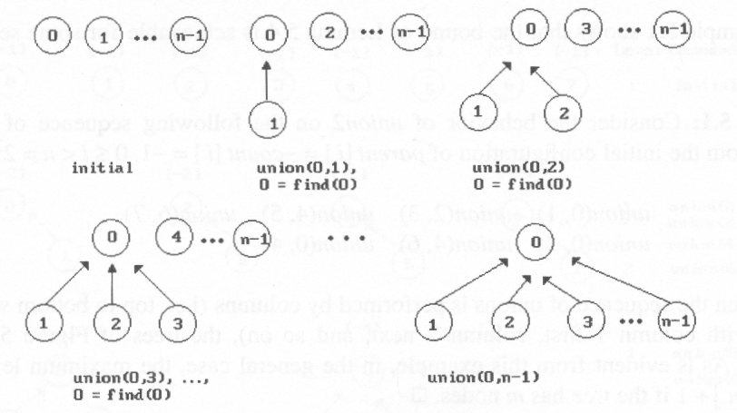
*Figure 5.44:Trees obtained using the weighting rule(p.243)

Slide 134
Modified Union Operation
void weightedUnion(int i, int j)
{
int temp = parent[i]+parent[j];
if (parent[i]>parent[j]) {
parent[i]=j;
parent[j]=temp;
}
else {
parent[j]=i;
parent[i]=temp;
}
}
// Keep a negative counter in the root of tree
// i has fewer nodes.
// j has fewer nodes
If the number of nodes in tree i is
less than the number in tree j, then
make j the parent of i; otherwise
make i the parent of j.

Slide 135
Worst Case of WeightedUnion
Lemma 5.5. Let T be a tree with n nodes created as a result of weightedUnion. No node in T has level greater than ⎣log₂ n⎦+1.
Proof:
If tree i has 1 node, #level = 1 = ⎣log₂1⎦+1
Assume, i has n-1 nodes, #level = ⎣log₂ n-1⎦+1
Tree i has n nodes and is union of the two trees (k, j)
That is, two trees k and tree j have (n-m) and m nodes, respectively (1 ≤ m ≤ n/2 )
Case 1. The height of i is the same as k
➔ ⎣log₂ n-m⎦+1 ≤ ⎣log₂ n⎦+1
Case 2. The height of i is one more than j
➔ ⎣log₂ m⎦+2 ≤ ⎣log₂ n/2⎦+2 ≤ ⎣log₂ n⎦+1

Slide 136
union operation
O(n) n-1
find operation
O(n²)
u union operation
O(u) u-1
f arbitrary find operations
O(f log u)

Slide 137
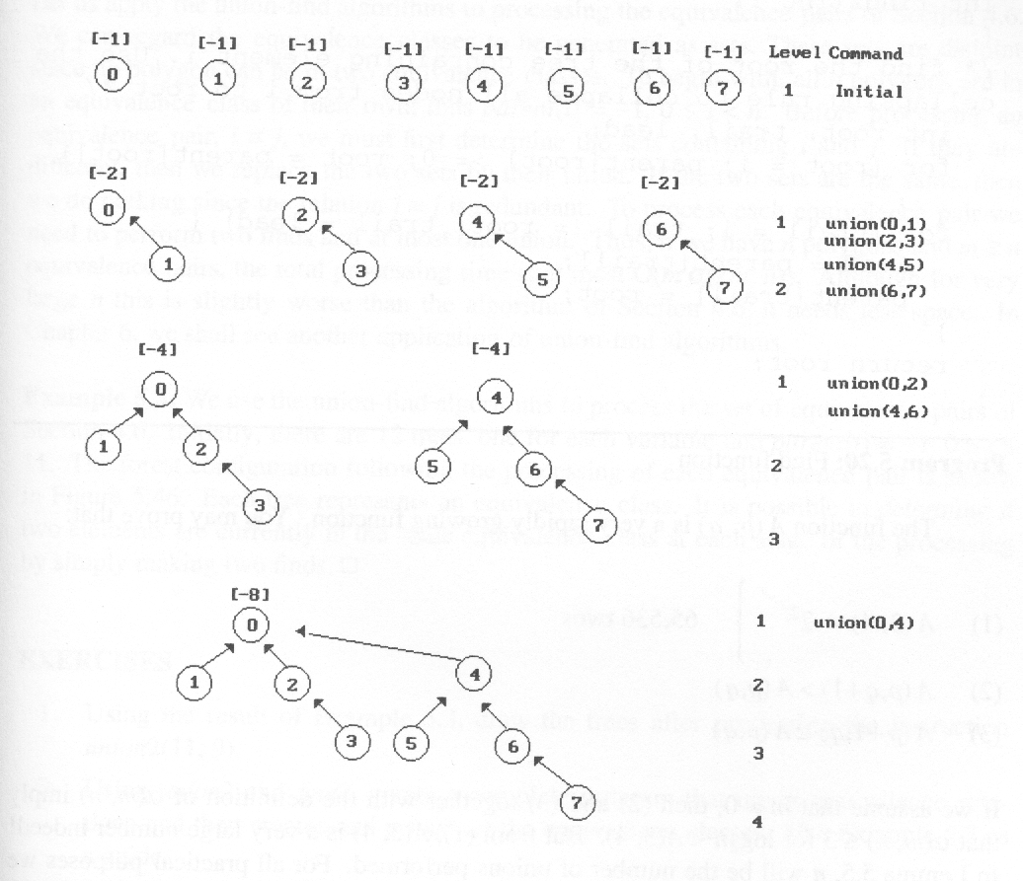
⎣ log₂8⎦+1
Figure 5.43: Trees achieving worst case bound (p.254)

Slide 139
Collapsing
0
1
2
4
3
5
6
7
find(7) find(7) find(7) find(7) find(7) find(7) find(7) find(7)
go up 3 3 3 3 3 3 3 3
24 moves

Slide 140

Collapsing
0
1
2
4
3
5
6
7
find(7) find(7) find(7) find(7) find(7) find(7) find(7) find(7)
go up 3 3 3 3 3 3 3 3
24 moves

Slide 141
Collapsing
0
0
1
2
4
1
2
4
6
7
3
5
6
3
5
7
find(7) find(7) find(7) find(7) find(7) find(7) find(7) find(7)
go up 3 1 1 1 1 1 1 1
reset 2
12 moves (vs. 24 moves)

Slide 142
Collapsing Rule
If j is a node on the path form i to its root and parent[i] ≠ root(i), then set parent[j] to root(i)
The first run of find operation will collapse the tree
Therefore, all following find operation of the same element only goes up one link to find the root

Slide 143
Modified Find(i) Operation
int collapsingFind(int i)
{
int root, trail, lead;
for (root=i; parent[root]>=0; root=parent[root]);
for (trail=i; trail!=root; trail=lead) {
lead = parent[trail];
parent[trail]= root;
}
return root:
}
If j is a node on the path from
i to its root then make j a child
of the root

Slide 144
Applications
Find equivalence class i ≡ j
Examine S_{i} and S_{j} where i ∈ S_{i} and j ∈ S_{j} (two finds)
S_{i} = S_{j} do nothing
S_{i} ≠ S_{j} union(S_{i} , S_{j})
example 0 ≡ 4, 3 ≡ 1, 6 ≡ 10, 8 ≡ 9, 7 ≡ 4, 6 ≡ 8, 3 ≡ 5, 2 ≡ 11, 11 ≡ 0 {0, 2, 4, 7, 11}, {1, 3, 5}, {6, 8, 9, 10}

Slide 145
0 ≡ 4, 3 ≡ 1, 6 ≡ 10, 8 ≡ 9, 7 ≡ 4, 6 ≡ 8, 3 ≡ 5, 2 ≡ 11, 11 ≡ 0 {0, 2, 4, 7, 11}, {1, 3, 5}, {6, 8, 9, 10}
[-1]
[-1]
[-1]
[-1]
[-1]
[-1]
[-1]
[-1]
[-1]
[-1]
[-1]
[-1]
0
1
2
3
4
5
6
7
8
9
10
11
(a) Initial trees
[-2]
[-2]
[-2]
[-2]
[-1]
[-1]
[-1]
[-1]
0
3
6
8
2
5
7
11
4
1
10
9
(b) Height-2 trees following 0≡4, 3≡1, 6≡10, and 8≡9

Slide 146
0 ≡ 4, 3 ≡ 1, 6 ≡ 10, 8 ≡ 9, 7 ≡ 4, 6 ≡ 8, 3 ≡ 5, 2 ≡ 11, 11 ≡ 0 {0, 2, 4, 7, 11}, {1, 3, 5}, {6, 8, 9, 10}
[-2]
[-2]
[-2]
[-2]
[-1]
[-1]
[-1]
[-1]
0
3
6
8
2
5
7
11
4
1
10
9
(b) Height-2 trees following 0≡4, 3≡1, 6≡10, and 8≡9
[-3]
[-4]
[-3]
[-2]
0
6
3
2
4
7
10
8
1
5
11
9
(c) Tree following 7≡4, 6≡8, 3≡5, and 2≡11

Slide 147
0 ≡ 4, 3 ≡ 1, 6 ≡ 10, 8 ≡ 9, 7 ≡ 4, 6 ≡ 8, 3 ≡ 5, 2 ≡ 11, 11 ≡ 0 {0, 2, 4, 7, 11}, {1, 3, 5}, {6, 8, 9, 10}
[-3]
[-4]
[-3]
[-2]
0
6
3
2
4
7
10
8
1
5
11
9
(c) Tree following 7≡4, 6≡8, 3≡5, and 2≡11
[-3]
[-4]
[-3]
0
6
3
4
7
2
10
8
1
5
11
9
(d) Tree following 11≡0

Slide 149
Distinct Binary Trees
How many distinct binary trees are there with n nodes?
n = 2 ➔ 2
n = 0 or 1 ➔ 1
n = 3 ➔ 5

Slide 150
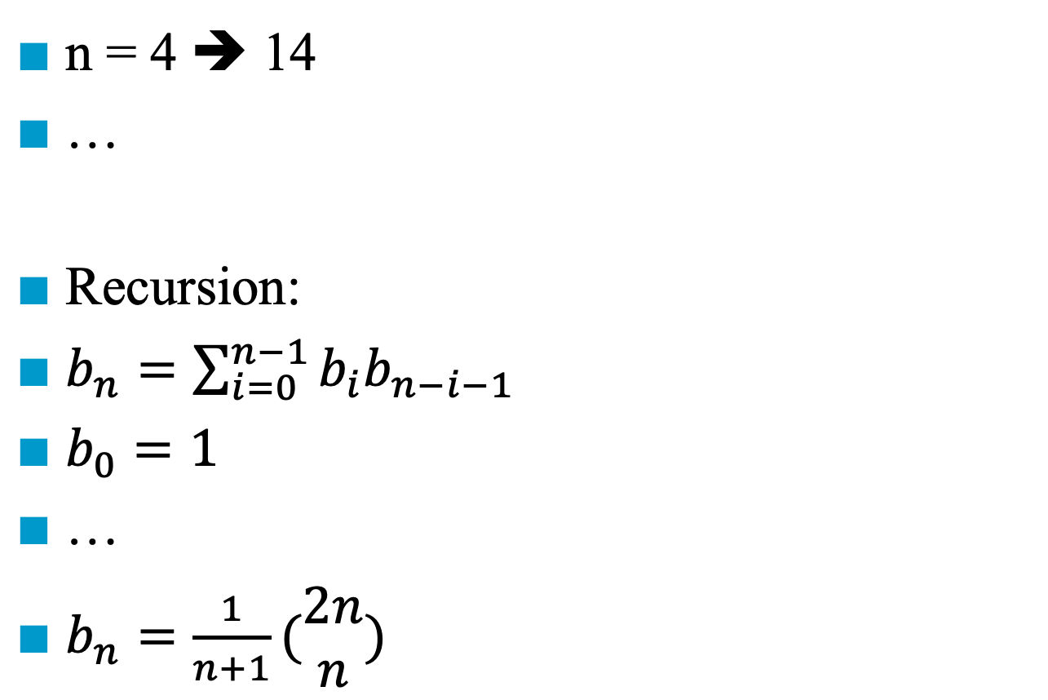
Distinct Binary Trees
n = 4 ➔ 14
…
Recursion:
$b_{n}=\sum_{i=0}^{n−1}{b_{i}b_{n−i−1}}$
$b_{0}=1$
…
$b_{n}=\frac{1}{n+1}(\begin{matrix}2n \\ n\end{matrix})$
n = 0 ➔ 1
n = 3 ➔ 5
n = 1 ➔ 1
n = 2 ➔ 2
n = 2 ➔ 2
n = 1 ➔ 1
n = 3 ➔ 5
n = 0 ➔ 1

Slide 151
Distinct Binary Trees
In Section 5.3 we introduced preorder, inorder, and postorder traversal of a binary tree. Now suppose we are given a sequence (e.g., inorder sequence BCAEDGHFI), does the sequence uniquely define a binary tree?
inorder: B C A E D G H F I

Slide 152
Constructing a Binary Tree from Its Inorder Sequence
inorder: B C A E D G H F I
A
E
B, C
D, E, F, G, H, I
A, B, C
D, F, G, H, I
An inorder traversal tells the sequence of the printf (or pop)
An inorder sequence cannot uniquely define a binary tree

Slide 153
Constructing a Binary Tree from Its Inorder Sequence
preorder: A B C D E F G H I inorder: B C A E D G H F I
A, B, C, D, E, F, G, H, I
A
B, C
D, E, F, G, H, I
A preorder traversal tells the sequence of the nodes to be visited (or push)
An inorder traversal tells the sequence of the printf (or pop)

Slide 154
Constructing a Binary Tree from Its Inorder Sequence
preorder: A B C D E F G H I inorder: B C A E D G H F I
A
A
B
D, E, F, G, H, I
B, C
D, E, F, G, H, I
C
A preorder traversal tells the sequence of the nodes to be visited (or push)
An inorder traversal tells the sequence of the printf (or pop)

Slide 155
Constructing a Binary Tree from Its Inorder Sequence
preorder: A B C D E F G H I inorder: B C A E D G H F I
A
A
B
D
B
D, E, F, G, H, I
C
E
G, H, F, I
C
An inorder sequence and a preoder sequence can uniquely define a binary tree (the proof is left as an exercise)

Slide 156
Constructing a Binary Tree from Its Inorder Sequence
preorder: A B C D E F G H I inorder: B C A E D G H F I
A
A
B
D
B
D
C
E
F
C
E
G, H, F, I
G, H
I
An inorder sequence and a preoder sequence can uniquely define a binary tree (the proof is left as an exercise)

Slide 157
Constructing a Binary Tree from Its Inorder Sequence
preorder: A B C D E F G H I inorder: B C A E D G H F I
A
A
B
D
B
D
C
E
F
C
E
G, H, F, I
G
I
An inorder sequence and a preoder sequence can uniquely define a binary tree (the proof is left as an exercise)
H

Slide 158
Distinct Binary Trees
Known: an inorder sequence and a preoder sequence can uniquely define a binary tree (the proof is left as an exercise)
preorder: 1 2 3
1
1
1
1
1
2
2
2
3
2
2
3
3
3
3
inorder:
(1, 2, 3)
(1, 3, 2)
(2, 1, 3)
(2, 3, 1)
(3, 2, 1)
Is it possible to have (3, 1, 2)?

Slide 159
Distinct Binary Trees
Known: an inorder sequence and a preoder sequence can uniquely define a binary tree (the proof is left as an exercise)
preorder: 1 2 3
1
1
1
1
1
2
2
2
3
2
2
3
3
3
3
inorder:
(1, 2, 3)
(1, 3, 2)
(2, 1, 3)
(2, 3, 1)
(3, 2, 1)
The number of distinct binary trees with n node is equal to the number of distinct inorder permutations with the same preorder

Slide 160
Distinct Binary Trees
Known: an inorder sequence and a preoder sequence can uniquely define a binary tree (the proof is left as an exercise)
preorder: 1 2 3
1
1
1
1
1
2
2
2
3
2
2
3
3
3
3
inorder:
(1, 2, 3)
(1, 3, 2)
(2, 1, 3)
(2, 3, 1)
(3, 2, 1)
LVR (inorder traversal) → PUSH and POP
➔ A stack permutation can uniquely define a binary tree

Slide 161
Preorder Permutation
A
1
D
2
4
B
C
3
5
6
E
F
G
7
9
I
H
8
preorder: A B C D E F G H I inorder: B C A E D G H F I

Slide 162
Constructing a Binary Tree from Its Inorder Sequence
preorder: A B C D E F G H I inorder: B C A E D G H F I
A
A
B
D
B
D, E, F, G, H, I
C
E
F
C
G
I
A stack permutation can uniquely define a binary tree
H

Slide 163
Level
1
2
3
4

